Slide 1

Towards a Better Future with AI-Embedded Solar Panels
By: Selina Dersarkissian

Slide 2
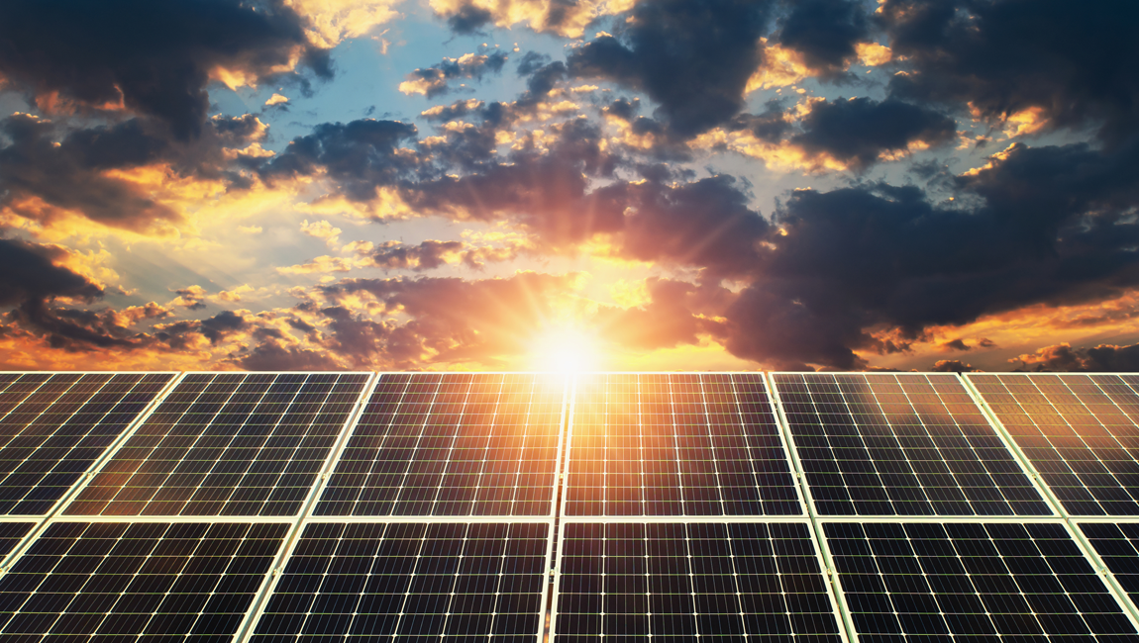
INTRODUCTION
Solar energy is the most abundant energy resource on Earth. Each day, it’s harvested as electricity or heat, fueling homes, businesses, and utilities with clean, emission-free power. As the world pivots towards sustainable energy solutions, solar power is crucial in shaping our global energy landscape.
How does it work?
Our sun generates an infinite amount of power. Solar energy technologies capture and convert that power into electricity that we can use in our homes and businesses. Solar panels are one way to harness the power of the sun they capture energy from sunlight, while solar thermal systems use the heat from solar radiation for heating, cooling, and large-scale electrical generation.

Slide 3
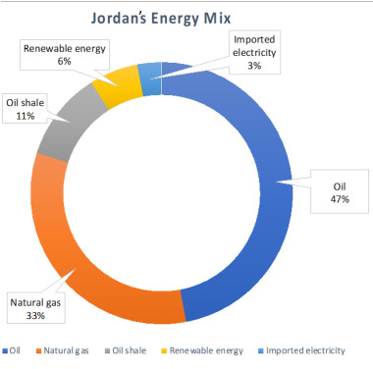
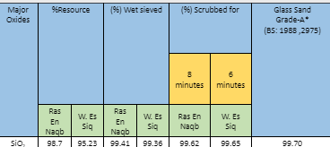
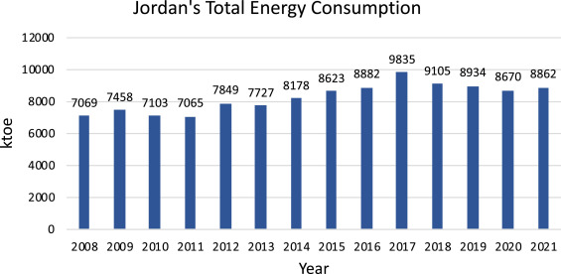
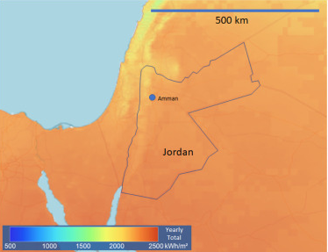
BACKGROUND INFORMATION
In Jordan, there are high levels of energy consumption and as the demand increases, Jordan is becoming more dependent on imported energy sources and non-renewable energy and only 6% of renewable energy. However, Jordan has a great potential in solar energy.
Solar panels can easily be implemented in Jordan, knowing that Jordan is a country which benefits from 5 to 7 kWh/m2 of direct solar radiation intensity, which is just suitable for solar panels. The country also averages 310 sunny days. As well as that Jordan has significant silica sand deposits that can be used for solar panels as silicon is the main metal used for them. According to the Jordan ministry of energy and mineral resources, it is found mostly in four areas (Ras En Naqb, Qa Disi, Wadi Siq and Petra), that are located in the south Jordan.
In 2009, Jordan Investment Board (JIB) in cooperation with The European Union did a pre-feasibility study about silicon metal production, showing results that Jordan can enter a phase in industry of renewable energy.

Slide 4
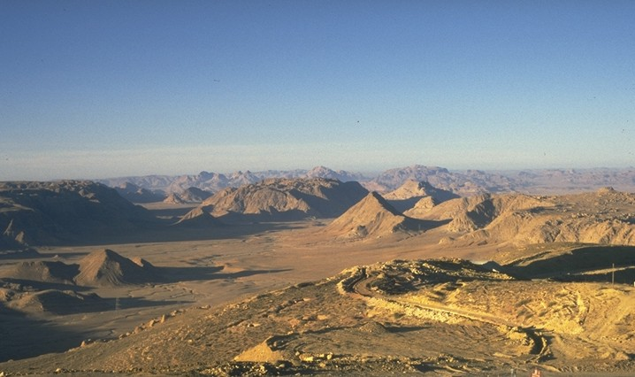
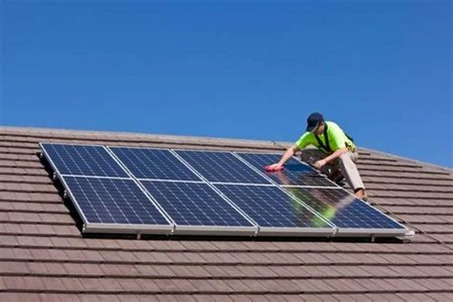
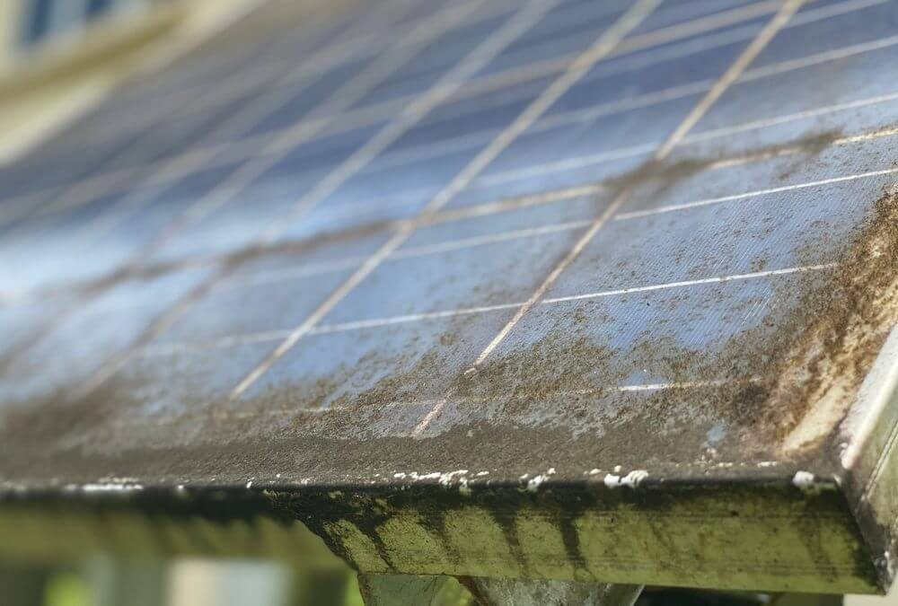
THE ISSUE
The issue here is that although those areas are rural areas and would be perfect for solar panel implementation, they have immense waves of dust, additionally there is a very few population there to hire people to clean and maintain them, especially that the process is not easy with entire solar plants that are extremely delicate and should be handled carefully. And for those individual solar panels on top of buildings, it would be rather dangerous for someone to constantly clean them and check for maintenance.
In addition to the different positions of the sun during daylight, for many hours of day the solar plants would absorb minimal solar energy for them being placed in another direction.
Areas in Ras En Naqab

Slide 5
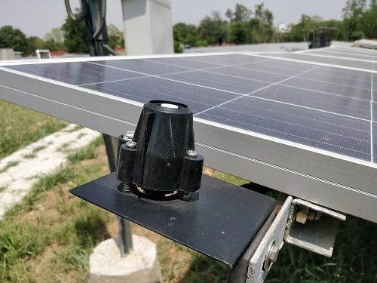
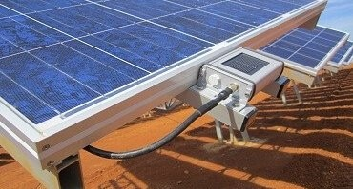
SOLUTION
For that, I came up with the solution to create AI-embedded solar panels that work on analyzing data of the solar panels and make predictions about maintenance needs, dust accumulation, sunlight intensity and position and thus make immediate adjustments to optimize performance and solve the issue.
Firstly, sensors need to be implemented on the solar panels; for instance: to collect data, (irradiance sensors to measure intensity of sunlight hitting the panels, temperature sensors, wind speed sensors, humidity sensors, soiling sensors that track accumulation of dust and dirt), and to work the data, (data loggers to store the data collected, voltage and current sensors to measure the electrical output and tilt and angle sensors to ensure the panels are positioned correctly.

Slide 6
SOLUTION STEPS
After that, the AI algorithm will use the data from the sensors about the operational performance and condition of the solar panels and continuously analyze them.
Data Collection: By now, the AI has both; collected data from sensors to monitor key performance indicators and detect environmental conditionals; and has stored data from the sensors (data logging).
Data Management: creating a data management system that aggregates the data from all the sensors and preprocesses the data by removing outliers and handling missing data.
Making Predictions: Identifying patterns to maintenance needs, dust accumulation, sun positioning and monitoring the continuous collected real-time data on energy outputs and environmental conditions.
Using Algorithms: using machine learning models and anomaly detection algorithms. The machine learning algorithms (Random Forest, Support Vector Machines, or Neural Networks) would make the predictions by analyzing the data and the anomaly detection algorithms identify anomalous data behavior indicating a malfunction or a performance decline due to certain conditions.
5. Adjustments: the AI uses its predictions to optimize energy output by AI algorithms, like Reinforcement Learning, to optimize and maximize sunlight exposure based on data by adjusting the orientation or tilt of the solar panel, or self-clean and maintain the solar panels by having delegate wipers programmed to clean the solar panels on command.
6. Feedback Loop: the AI system learns from the outcomes and creates maintenance schedules, as well as reinforcing certain orientations for greater solar energy absorption.

Slide 7
THE PROCESS
Implementing sensors
Collecting data
Managing data
Making predictions
Using Algorithms
Making adjustments
Creating feedback loops
Continuous improvements

Slide 8
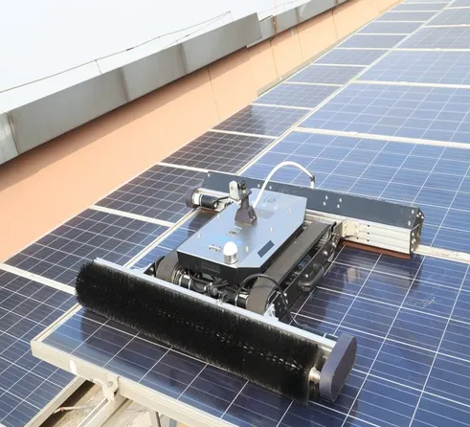
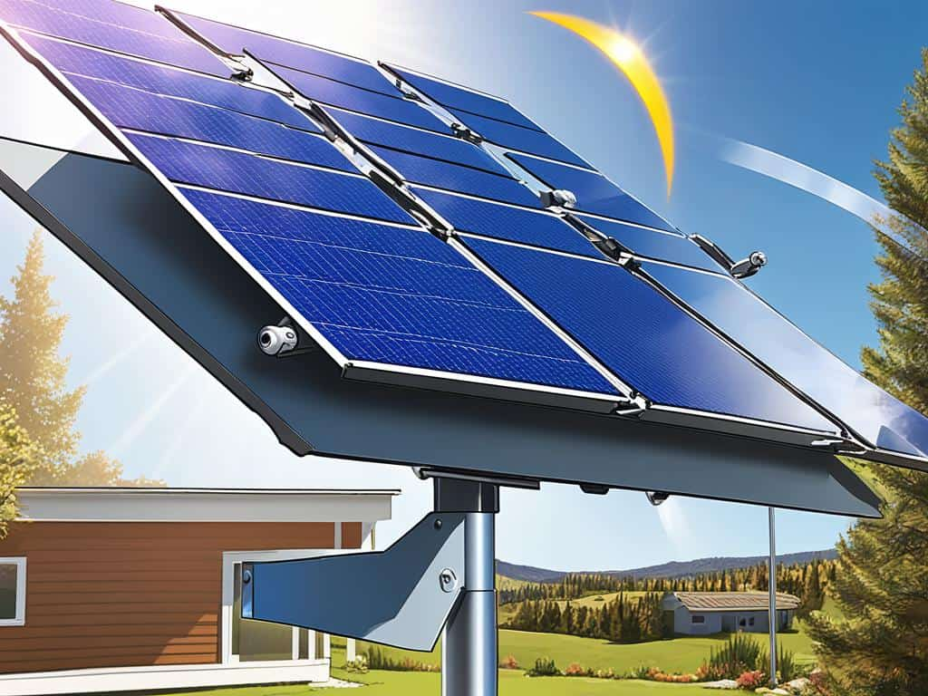
OUTCOMES AND RESULTS
OUTCOMES
RESULTS
Although, the implementation would be a bit costly, it could be funded by the World Bank and by partnerships with companies, and on the long-run it would save Jordan many costs (especially that with these implementations, there would be no maintenance costs and maximized energy output) and Jordan will also be able to pay back the companies. With this solution, Jordan will have enough energy in a few years and could even start importing energy to neighboring countries. This would change Jordan’s energy mix to it supplying itself with its own energy reducing CO2 emissions by 369 thousand tons per year. According to research, households in Jordan can save up to 90 per cent of their monthly electricity bill by installing photovoltaic systems to produce energy from solar power indicating that an entire solar panel plant would even save more.
Dust accumilation and maintanence
Sun tracking
Self-cleaning and maintenance solar panels
Tilting solar panels that follow Sun position
District one has a priority and the green light flashes.

Slide 9
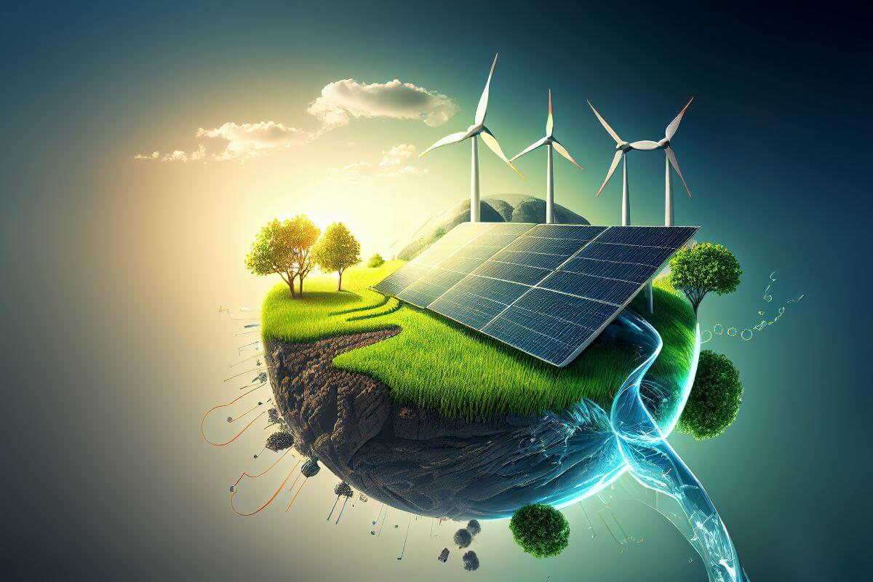
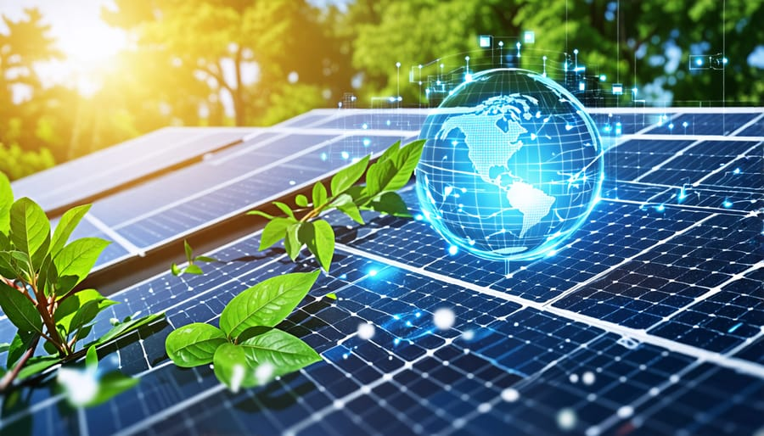
CONCLUSIONS AND FUTURE WORKS
Conclusion
In conclusion, to maximize energy output from solar panels and ensure they are effeciently working at peak performance; my AI-embedded solar panels work on optimizing solar energy absorption by adjusting its orientation and self-cleaning itself by its wiper that occur through predictions of different AI algorithms.
Future works
In the future, to further elaborate on my idea of AI-embedded solar panels, other AI algorithms could be integrated into energy management systems to predict energy consumption patterns and manage battery storage effieciently in order not to waste any excess energy generated and instead redirect it to battery storage or the smart grid; significantly improving the effectiveness of managing solar energy, resulting in lower costs, enhanced reliability, and a more sustainable energy future.

Slide 10
THANK YOU FOR
YOUR TIME

